Slide 1
Introduction to Distributed Systems
Prepared By: Pratima Gautam

Slide 2
Agendas:
Definition
Motivation for Distributed Systems
Architectural Categories
Characteristics, Issues and Goals
Advantages
Disadvantages

Slide 3
Introduction to Distributed Systems
A distributed system is a collection of the independent computers, interconnected via a network, capable of collaborating on a task.
A distributed system can be categorized as a collection of multiple autonomous computers (each consisting of CPU’s, local memory, stable storage, I/O paths connecting to the environment, Geographically Distributed) that communicate over a communication network.

Slide 4
Definition (Continued …)
Distributed system is a collection of independent entities that cooperate to solve a problem that cannot be solved individually
So, basically it is nothing but a collection of computers
Distributed Control System (DCS) do not share a common memory or do not have a common physical clock, and the only way they can communicate is through the message passing and for that they require a communication network.
No physically synchronous global clock within the system so that that the various activities in the distributed environment can be synchronized)
Access to geographically remote data and resource

Slide 5
Distributed System Overview
A distributed system is a collection of independent computers that appears to its users as a single coherent system
Distributed systems connects autonomous processors by communication network
The software component that run on each of the computer use the local operating system and network protocol stack
The distributed software is termed as middleware
The distributed execution is the execution of the processes across the distributed systems to collectively achieve a common goal.

Slide 6
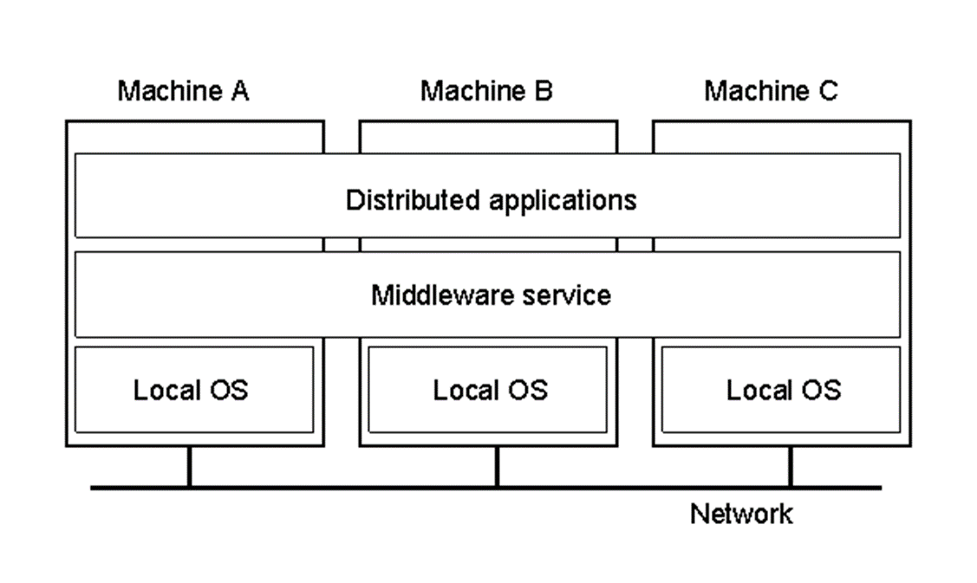
Examples:
The Web
Processor Pool
Airline Reservation
A distributed system organized as middleware.
Note that the middleware layer extends over multiple machines.
Users can interact with the system in a consistent way, regardless of where the interaction takes place

Slide 7
Motivation for Distributed Systems
Inherently distributed computation that is many application such as money transfer in the banking, or reaching the consensus among the parties that are geographically distant, the computation is inherently distributed.
Resource sharing the sharing of resources among such as peripherals, and a complete data set and so on and so forth.
Access the geographically remote data and resources, such as bank database, supercomputer and so on.
Reliability enhanced reliability possibility of replicating the resources and execution to enhance the reliability

Slide 8
Architectural Categories for Distributed Systems
Computer architectures consisting of interconnected, multiple processors are basically of two types:
Tightly Coupled System
Loosely Coupled System

Slide 9
Tightly Coupled Systems
In these systems, there is a single system wide primary memory (address space) that is shared by all the processors. Usually tightly coupled systems are referred to as parallel processing systems.

Slide 10
Loosely Coupled Systems
In these systems, the processors do not share memory, and each processor has its own local memory. Loosely coupled systems are referred to as distributed computing systems, or simply distributed systems.

Slide 11
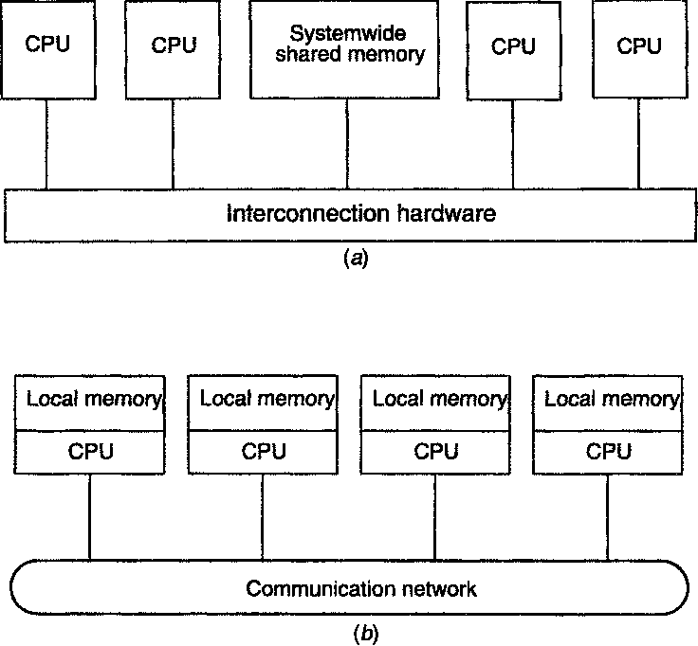

Slide 12
Characteristics of Distributed System
Concurrency
No global clock
Independent failures
Enhanced reliability
Fault tolerant: Distributed systems must maintain availability even at low levels of hardware/software/network reliability.
Scalable
Increased Performance / Cost Ratio

Slide 13
Concurrency
Components in distributed systems are executed in concurrent processes.
Components access and update shared resources (e.g. variables, databases, device drivers).
Integrity of the system may be violated if concurrent updates are not coordinated.
Lost updates
Inconsistent analysis
Notes:
Components in distributed systems are executed concurrently. There may be many different people at different teller machines. Likewise, there are many different users working in a local area network.
While these components access shared resources, the resources have to be protected against integrity violations that may be introduced through concurrency.
As an example for a lost update, consider that you withdraw 50 dollars. This requires the bank´s account database to compute:
debitbalance = balance-50; /* Op1 */
balance = debitbalance; /* Op2 */
If a clerk in the bank credits a check of 100 dollars the following computation has to be done:
creditbalance = balance+100; /* Op3 */
balance = creditbalance; /* Op4 */
If these two modifications to your account are done concurrently the integrity of the account data may be violated in two ways:
1. your debit may not be recorded (bad luck for the bank) if the schedule is (Op1, Op3, Op2, Op4).
2. the credit of your check may not be recorded (bad luck for you) if the schedule is (Op3, Op1, Op4, Op2).
These situations have by all means to be avoided.
Concurrency control facilities (such as locking) are needed in almost any concurrent system.

Slide 14
Failure Handling (Fault Tolerance)
Hardware, software and networks fail!
Distributed systems must maintain availability even at low levels of hardware/software/network reliability.
Fault tolerance is achieved by
recovery
redundancy
Notes:
Hardware, software and networks are not free of failures. They fail either because of software errors, failures in the supporting infrastructure (power-supply or air-conditioning), misuse of their users or just because of aging hardware. The average life time of hard disks are between two and five years, much less than the average life-time of a distributed system.
Given that there are many processors in a distributed system, it is much more likely that one of them fails than it is that a centralized system fails.
Distributed system, therefore, have to be built in a way that they continue to operate, even in the presence of failures of some of its components.
A distributed system can even achieve a higher reliability than a centralized system if distribution and replication is exploited properly.
Two different means have to be deployed to achieve fault tolerance: recovery and redundancy.
Components that are able to recover from failures have been built in a way that they react in a controlled way if they rely on services of components that have failed.
Redundant hardware, software and data decreases the time that is needed after a failure to bring a system up again.

Slide 15
Design Issues of Distributed Systems
Transparency
Flexibility
Reliability
Performance
Scalability

Slide 16
Transparency
How to achieve the single-system image, i.e., how to make a collection of computers appear as a single computer. Complexity of the distributed systems should be hidden from the users.
Hiding all the distribution from the users as well as the application programs can be achieved at two levels:
hide the distribution from users
at a lower level, make the system look transparent to programs.
1) and 2) requires uniform interfaces such as access to files, communication.
Notes:
The complexity of distributed systems should be hidden from their users. They should not have to be aware whether the system they are using is centralized or distributed. Thus, it is transparent for the user that s/he is using a distributed system.
For the administrators of the system, however, this is not true. For them, it may well be important (e.g. during load balancing) to know which component resides on which machine.

Slide 17
Transparency
Location Transparency: users cannot tell where hardware and software resources such as CPUs, printers, files, data bases are located.
Migration Transparency: resources must be free to move from one location to another without their names changed. E.g., /usr/lee, /central/usr/lee
Replication Transparency: OS can make additional copies of files and resources without users noticing.
Concurrency Transparency: The users are not aware of the existence of other users. Need to allow multiple users to concurrently access the same resource. Lock and unlock for mutual exclusion.
Parallelism Transparency: Automatic use of parallelism without having to program explicitly. The holy grail for distributed and parallel system designers.
Users do not always want complete transparency: a fancy printer 1000 miles away

Slide 18
Reliability
Distributed system should be more reliable than single system. Example: 3 machines with .95 probability of being up. 1-.05**3 probability of being up.
Availability: fraction of time the system is usable. Redundancy improves it.
Need to maintain consistency
Need to be secure
Fault tolerance: need to mask failures, recover from errors.

Slide 19
Flexibility
Make it easier to change
Monolithic Kernel: systems calls are trapped and executed by the kernel. All system calls are served by the kernel, e.g., UNIX.
Microkernel: provides minimal services. 1) IPC 2) some memory management 3) some low-level process management and scheduling 4) low-level i/o E.g., Mach can support multiple file systems, multiple system interfaces.

Slide 20
Performance
Without gain on this, why bother with distributed systems.
Performance loss due to communication delays:
fine-grain parallelism: high degree of interaction
coarse-grain parallelism
Performance loss due to making the system fault tolerant.

Slide 21
Scalability
Systems grow with time or become obsolete. Techniques that require resources linearly in terms of the size of the system are not scalable.
e.g., broadcast based query won't work for large distributed systems.
Examples of bottlenecks
Centralized components: a single mail server
Centralized tables: a single URL address book
Centralized algorithms: routing based on complete information

Slide 22
Scalability (Continued…)
Adaptation of distributed systems to
accommodate more users
respond faster (this is the hard one)
Usually done by adding more and/or faster processors.
Components should not need to be changed when scale of a system increases.
Design components to be scalable!
Notes:
Centralized systems often create bottlenecks as soon as a certain number of users are reached.
Distributed systems can be built in a way that these bottlenecks are avoided.
Then new processors can be added to accommodate new users. The Internet grows every day by adding new sites.
Other internet sites are not affected by these additions. They do not have to be changed.
However, components in distributed systems have to be designed in a way that the overall system remains scalable.
Sometimes it is required to relocate components, i.e. to migrate them to new processors. Relocation is required to populate new processors with components and to remove a certain amount of load from existing processors.
Then it is important that no or only very little assumptions are made on the location of components, both within the component itself and also within other components that use the component. Otherwise these components having explicit location information have to be changed whenever a component is relocated.

Slide 23
Examples of Distributed Systems
Database Management System
Automatic Teller Machine Network
Internet/World-Wide Web
Mobile and Ubiquitous Computing

Slide 24
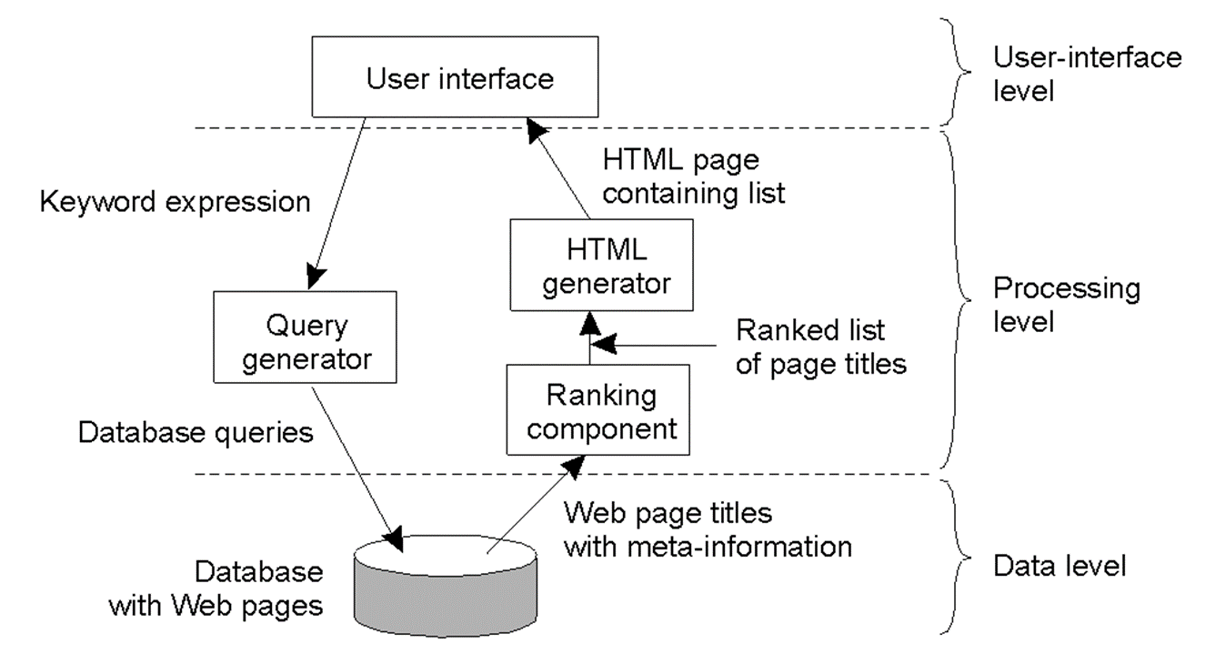
Client Server Implementation Level
Example of an Internet search engine
UI on client
Processing can be on client or server
Data level is server, keeps consistency

Slide 25
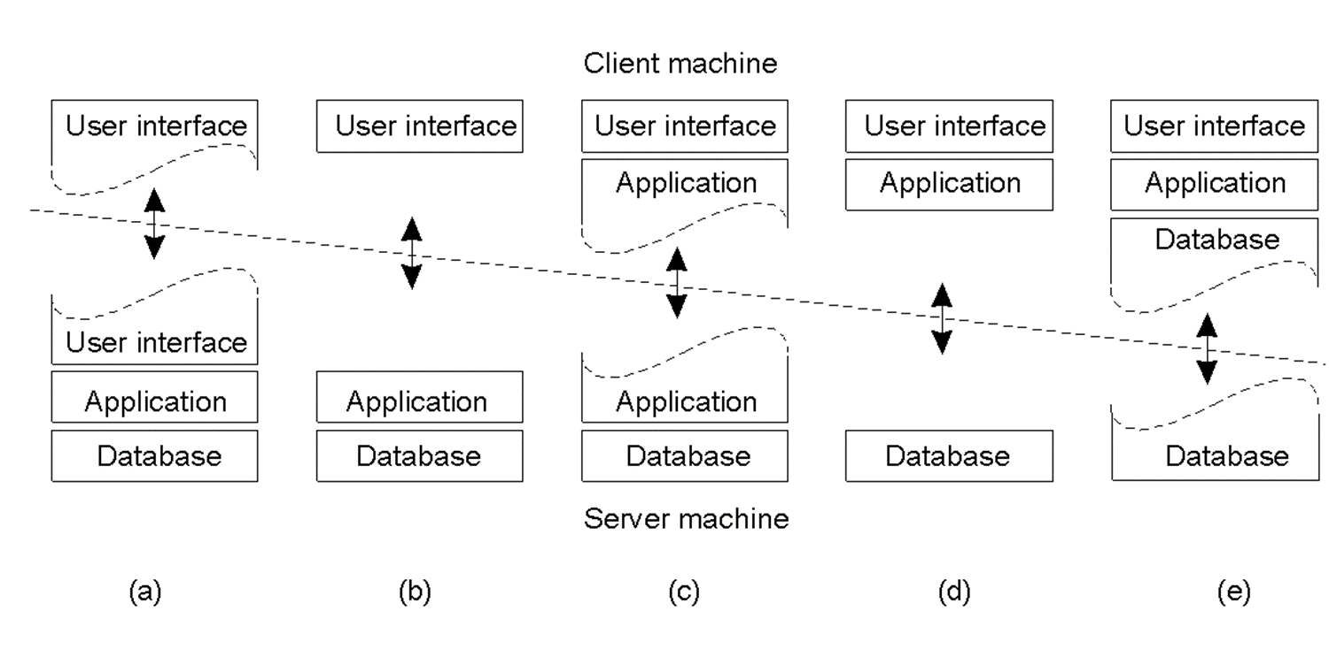
Multi Tiered Architectures
Thin client (a) to Fat client (e)
(d) and (e) popular for NOS environments

Slide 26
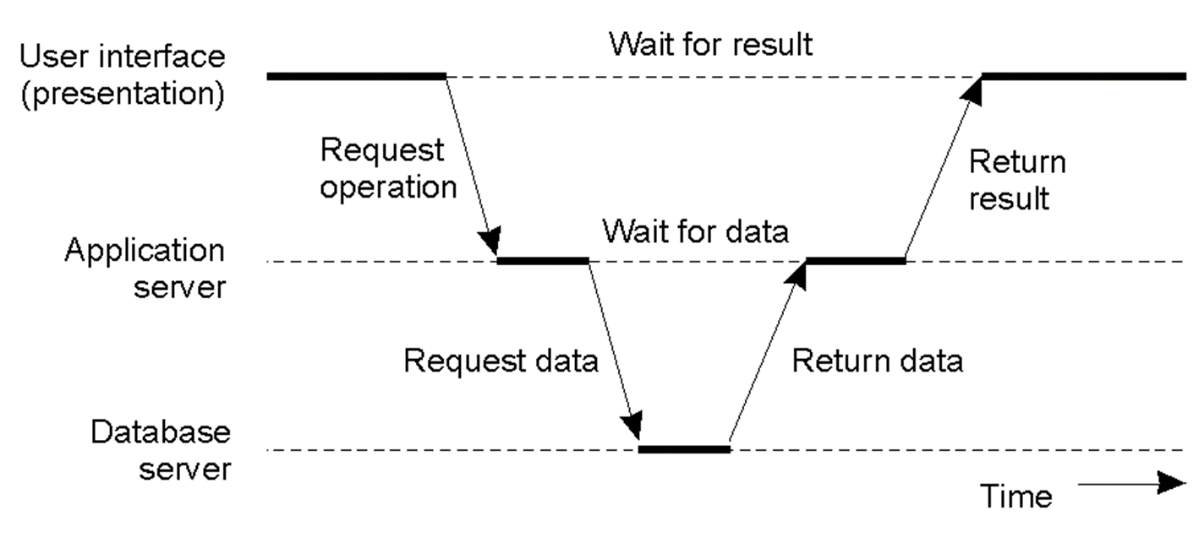
Multi Tiered Architectures: 3 tiers
Server may act as a client
Example would be transaction monitor across multiple databases

Slide 27
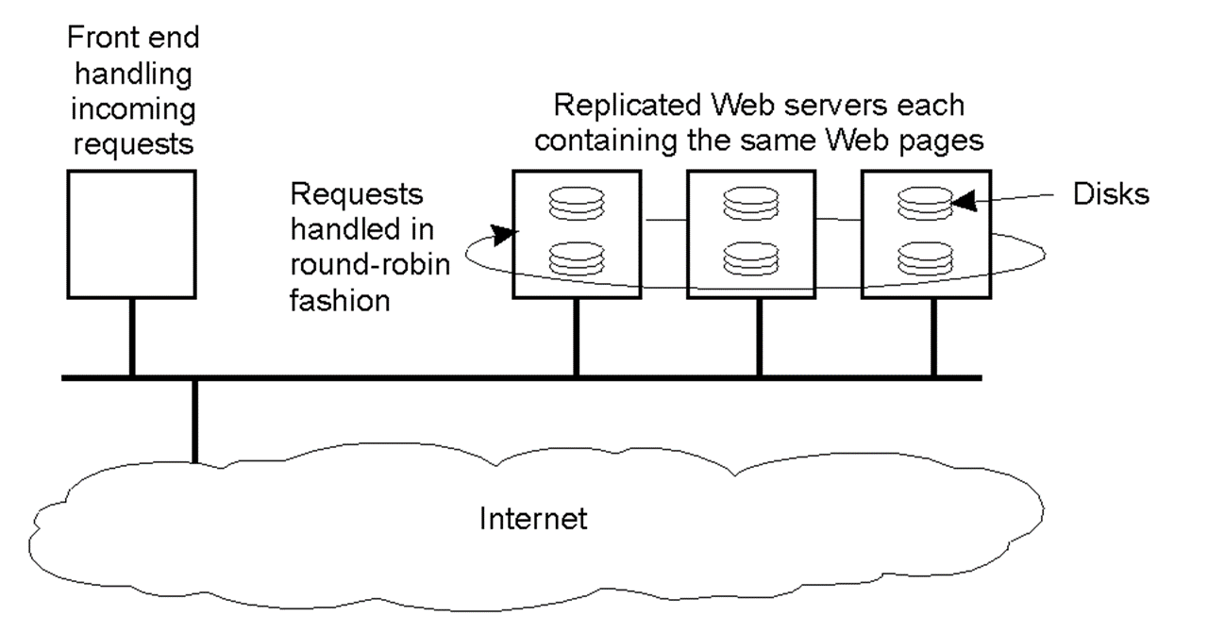
Modern Architectures: Horizontal
Rather than vertical, distribute servers across nodes
Example of Web server “farm” for load balancing
Clients, too (peer-to-peer systems)

Slide 28
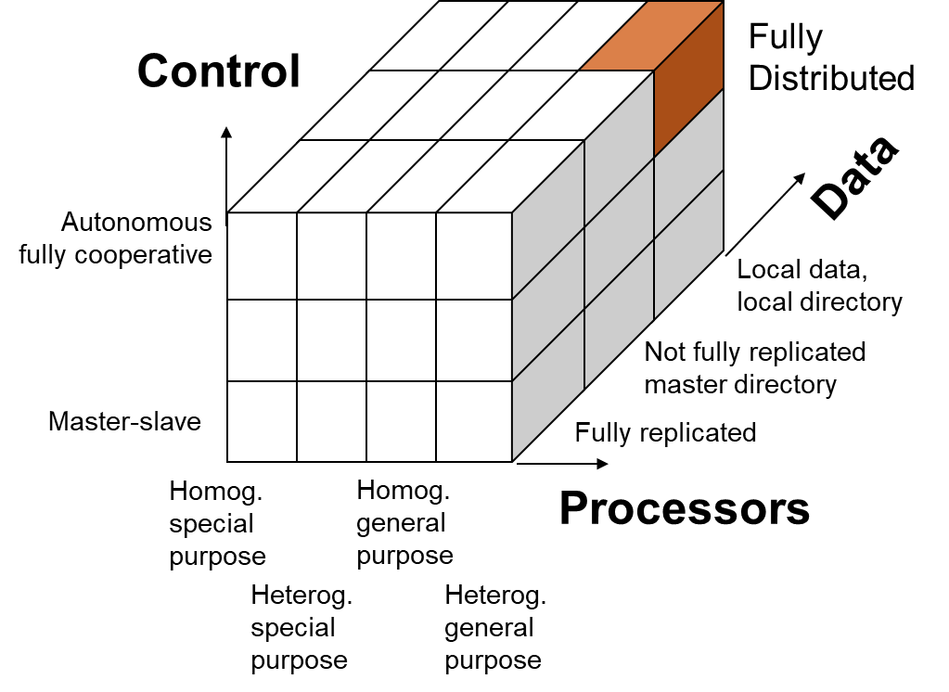
Figure: Distributed System Types
Different dimensions have to be distributed for Hardware (processors), application and system software (control) and application and system information (data)
Notes:
Systems involve hardware (processors), application and system software (control) and application and system information (data).
Which of these dimensions have to be distributed for the system to be a distributed system?
Enslow requires that distribution is transparent and system users are unaware of the fact that the system is composed of multiple processors.
Enslow´s model (1978) is fairly rigid: A system is a fully distributed system if and only if all dimensions are fully decentralized.
– Full hardware decentralization includes multiple heterogeneous control units (as opposed to a single control unit with multiple processors and multiple homogeneous control units).
– Control must be provided by multiple units cooperating with each other rather than in a master-slave relationship
– Data must be partitioned and/or replicated, each part with its own local directory.
Enslow´s definition is too restrictive in our opinion. Techniques of distributed system construction should also be employed if only a single dimension is decentralized.

Slide 29
Advantages of Distributed Systems over Centralized Systems
Economics: a collection of microprocessors offer a better price/performance than mainframes. Low price/performance ratio: cost effective way to increase computing power.
Speed: a distributed system may have more total computing power than a mainframe. Ex. 10,000 CPU chips, each running at 50 MIPS. Not possible to build 500,000 MIPS single processor since it would require 0.002 nsec instruction cycle. Enhanced performance through load distributing.
Inherent distribution: Some applications are inherently distributed. Ex. a supermarket chain.
Reliability: If one machine crashes, the system as a whole can still survive. Higher availability and improved reliability.
Incremental growth: Computing power can be added in small increments. Modular expandability
Another deriving force: the existence of large number of personal computers, the need for people to collaborate and share information.

Slide 30
Advantages of Distributed Systems over Independent PCs
Data sharing: allow many users to access to a common data base
Resource Sharing: expensive peripherals like color printers
Communication: enhance human-to-human communication, e.g., email, chat
Flexibility: spread the workload over the available machines

Slide 31
Disadvantages of distributed systems
Software: difficult to develop software for distributed systems
Network: saturation, lossy transmissions
Security: easy access also applies to secrete data

Slide 32
Thank you!

